Slide 1
KEERTHANA S
Final Project
Register no: 412721205026

Slide 2
HAND GESTURE RECOGNITION USING DEEP LEARNING with CNN algorithm

Slide 3


AGENDA
Problem statement
Project overview
End user
Solution
Model
Result
3/21/2024 Annual Review

Slide 4

PROBLEM STATEMENT
Sign language is the principal mode of communication for the deaf and dumb community.
Conversing with people having such disabilities is a vital challenge faced by normal people.
As a result, there is a need for solutions that can considerably reduce the requirement for human interpreters and lead to more easy communication between non-signers and signers.

Slide 5

PROJECT OVERVIEW
The goal of this study is to create an efficient model that can precisely identify gestures and transform them into a perceivable format.
Deep learning model such as CNN (Convolution Neural Network) utilized in this project.
The built models were evaluated using Mean Average Precision.
The experimental results indicate that the proposed solution achieves the maximum accuracy, with a Mean Average Precision of 82.7%.

Slide 6

WHO ARE THE END USERS?
Sign language is difficult to understand by the normal people. so this project is concerntrate on normal people as end users to understand the signs without mediators.

Slide 7

YOUR SOLUTION AND ITS VALUE PROPOSITION
To reduce the inconvinence for understanding the signs we have developed a model using CNN algorithm trained with datasets with 82.7% of accuracy.
Implementing this in a online meeting helps to easily communicate with the disable people.

Slide 8

THE WOW IN YOUR SOLUTION
This project helps us to undestand the sign lanuguage and implementing this in a meeting helps people to understand and communicate with the disabled people.
In this prjoect deep learning alogrithm CNN is used wich provides high accuracy
3/21/2024 Annual Review

Slide 9
MODELLING
Dataset creation train, test, val
Training
model
CNN design
Data preprocessing
Load model
Test
Pre-process
input image
Classification

Slide 10

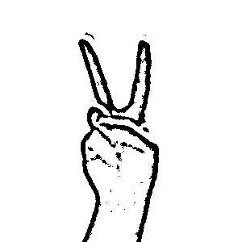
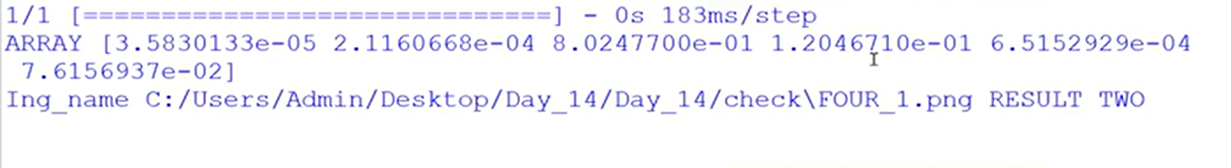
RESULTS
The model predicts the input accurately and provides the output
ACCURACY
INPUT
OUTPUT
The model predicted the input image as TWO

